Slide 1
Going Electric?
Should you ditch gas vehicles and go electric?

Slide 2
Why go Electric
Electric and other “cleaner alternative” fuel sources are the Future
Climate Change
Rising Gas Prices
NC- $3.69 FL- $4.00 CA- $5.80
PA- $4.29 TX- $3.72

Slide 3
Fuel Cost

Slide 4
Issues with Going Electric
Initial Cost
Limitations
Maintenance

Slide 5
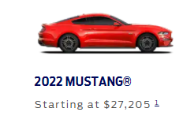
Cost of buying
FORD

Slide 6
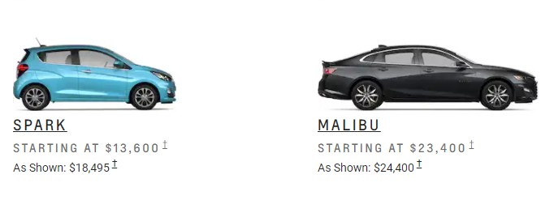
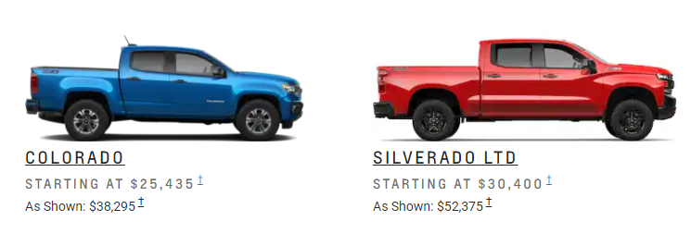
Cost of buying…
CHEVROLET

Slide 7
Cost of buying…
JEEP

Slide 8
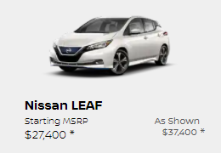
Cost of buying…
NISSAN

Slide 9
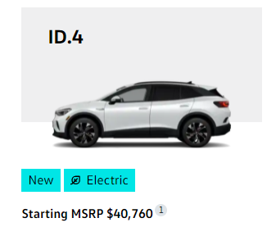
Cost of buying…
VOLKSWAGON

Slide 10
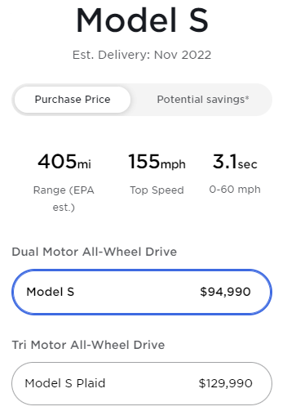
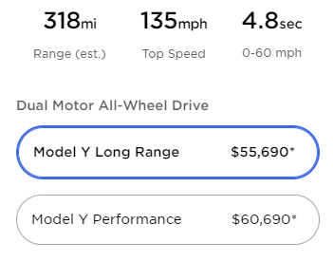
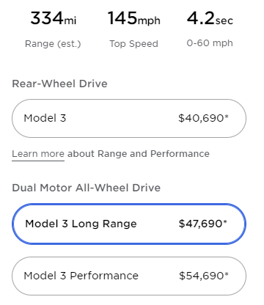
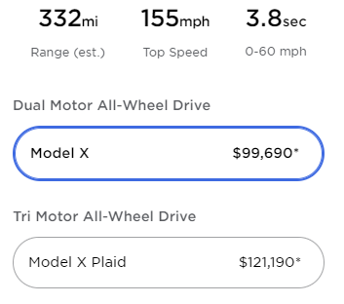
Cost of buying…
TESLA

Slide 11
Average incomes
Single Earner- $56,946
2 person Income- $73,154
November 2020- March 2021

Slide 12
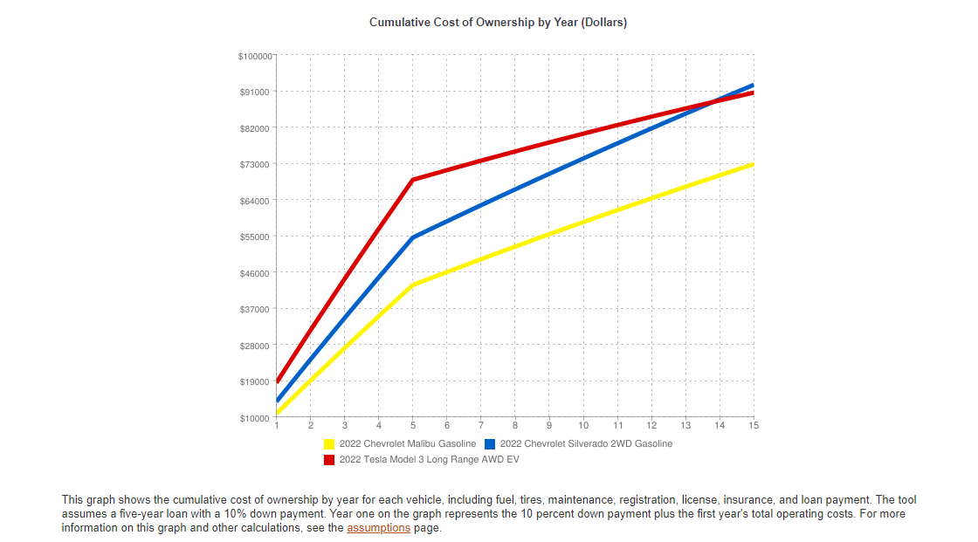
Cost per year

Slide 13
EV Limitations
Chevrolet Bolt EV
Jeep Wrangler 4x4e
Ranges From 226-396
Gas and Electric Hybrids
Nissan Leaf
Note- Use of heating systems can shorten ranges
Model X
Model S
Model X
Model 3 Long Range

Slide 14
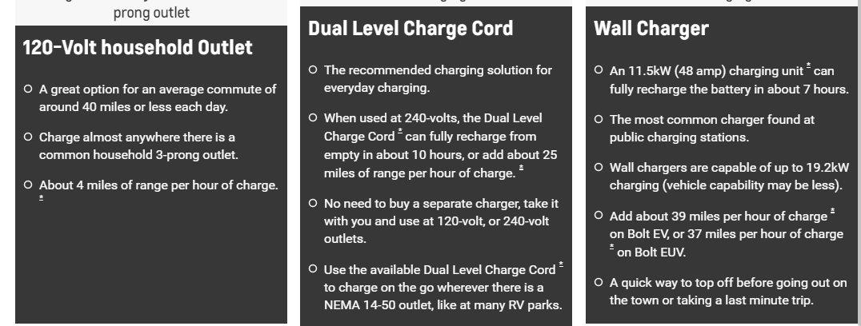
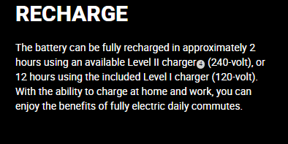
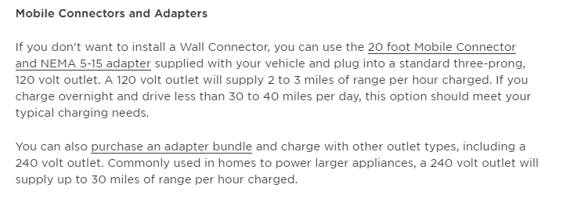
Charging
Chevy
4 Mi/per hr chg (Included)
25 Mi/ per hr chg (Not Included)
37Mi/ per hr chg (Not Included)
Jeep
Lvl 1- 12 hr recharge (Included)
Lvl 2- 2 hr recharge (Not Included)
Consider individuals like those who live in apartments or townhomes that need to park on the street or in parking lots. They may not have secure means to charge their vehicles.
Tesla
Standard Wall- 2-3 Mi/ per hr recharge (Included)
Wall Connector- 44 Mi/ per hr recharge (Not Included)

Slide 15
Charging on the go
Fast Charging
Convenient Locations
Provides Travel Options

Slide 16
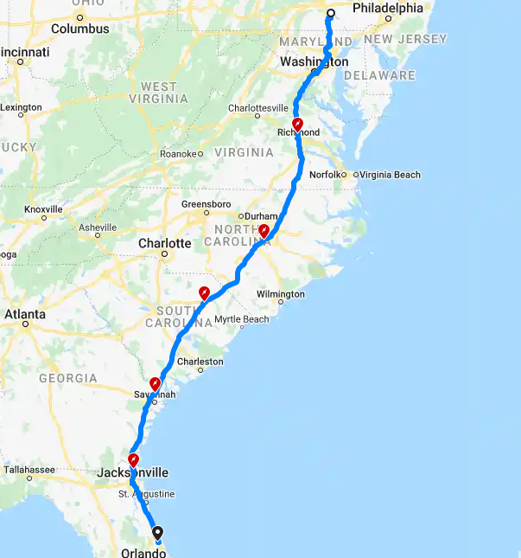
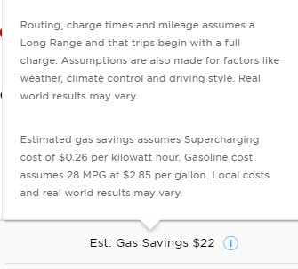
Travel

Slide 17
Maintenance
EVs still use oil for components
Special tools required for use on EVs
Personal Protective Equipment
Certifications
Costly to Maintenance Shop
Difficult

Slide 18
Making a decision
EVs
Future of Motor Vehicles
Environmental Improvement
Rising prices of oil and fossil fuels
Gas Powered Vehicles
Initial Cost and Affordability
Easier and more efficient travel
More Options

Slide 19
Questions?

