Slide 1
Evaluating the new business venture for: premier outdoor living
Shane Keilholtz
American Public University
MGMT410: Strategic management
Prof. Tom Javarinis
11 May 2025

Slide 2
What to Discuss
What is “Premier Outdoor Living”
SWOT Analysis
What Makes Premier Different
Things to Consider
What’s to Gain
What Stands in the Way
What is Needed
Notes:
We will discuss what Premier Outdoor Living is, our new company. Go over our SWOT analysis. Express what our start-up needs are, what makes Premier stand out, and what is lacking. Cover some things that we need to be aware of in the market, what is to be gained, and what could stand in our way.

Slide 3
Premier Outdoor Living Anywhere, FL
Cutting | Trim
Landscaping | Retaining Walls
Irrigation Systems | Seeding and Seasonal Treatments
Notes:
Premier outdoor living will be the go-to place to get anything needed for your outdoor living. There is no need to go anywhere else to give your home or business the curb appeal you are looking for and the oasis you desire.
Offering professional service with years of experience to have the grass and surrounding greens trimmed and cleaned. Creating a warm and welcoming first look at the property
Landscaping for those who have trees, flowers, and bushes that can either be planted or kept nice
Retaining wall construction to ensure everything stays where it should
Irrigation systems that will keep it looking healthy
Then, for those places that aren’t quite right, Premier treats the areas to get them up to speed

Slide 4
*Provided by Canva.com
Notes:
Our SWOT analysis goes over the company’s outlook as it enters the market.
The strength of this company is everything it does. If there is a small issue or a big one, Premier can help. There are membership programs that allow for discounts and treatment plans. Then, a guarantee on the work done
Weaknesses could be in our employee retention and building up. There is a start-up cost that can prove to be a challenge. Then, the changing of the seasons can create issues for quality.
The company will have some major opportunities in business and residential services. There is also a plan for Philanthropy to build things for needy and deserving organizations.
There will always be competition in this market. There is a unique challenge to build our clients into a profitable business.

Slide 5
To get Started:
Employees
We have already acquired our lead in James Robert Jones. ”Jim Bob”- $42k-$75k annually
Has 30 years experience
Construction Experience
CDL and Large Machinery Certifications
Hiring Outdoor Service Employees
4 Teams of 3 personnel for Outdoor
2 Mowing Teams- $13-$17 hr
1 Construction Team $34 hr
1 Irrigation team- $16-$22 hr
All outdoor teams can fall under Mowing duties on any given day
Incentives for Acquiring Certifications
1 HR and Website team
Will have Manager overseeing Customer service and Website -$64k annually
2 Customer service team members- $10-$20 hr
1 Website technician- $36 hr
Photo by Luis Negron
Notes:
We have established a partner and experienced leader for the company. Great experience and qualifications, and I believe he can build the workforce, which is our bread and butter. You see our penitential impact from all the salaries listed here for our workforce. We imagine 4 total teams to handle our entire workload. All teams will have the ability to complete our Mowing contracts and agreements. We will have individuals qualified to build walls and provide construction needs, such as transporting and operating the equipment and machinery. There is also a knowledgeable individual who can provide our irrigation for our customers. These employees will be informed of incentives and bonuses that could result from acquiring certifications, including remuneration for the training once complete. Lastly, HR force and website manager. These will handle customers and our online portal. We can take valuable input for improvements from these individuals as the company begins to take on work.

Slide 6
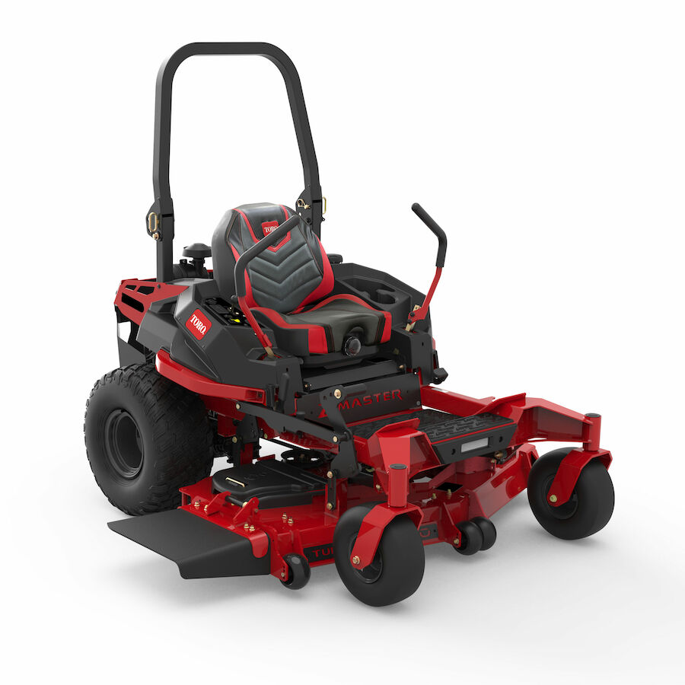
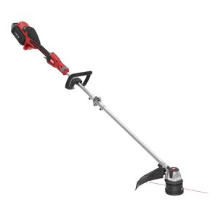
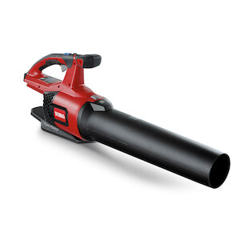
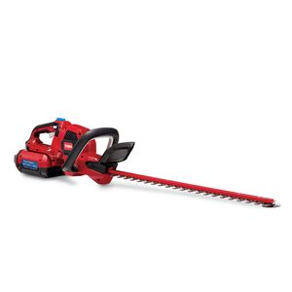
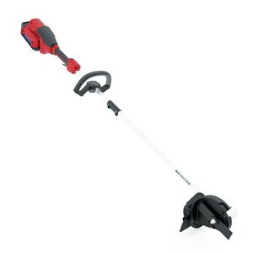
To get Started:
Mowing
Zero Turn Mowers x3: Estimate $5k-$10k per
Grass Trimmers x3: Estimate $200 per
Blowers x3: Estimate $200- $400 per
Hedge Trimmers x3: Estimate $200 per
Edgers x3: Estimate $200 per
Photos from Toro.com
Notes:
For our lawn teams, the equipment is planned to include 1 additional piece for bringing on the other teams as needed. We have our commercial mower to handle the large area of the project. Depending on the needs, the blowers, edgers, and trimmers could inflate, but getting started is essential to have at least 2 sets for projects.

Slide 7
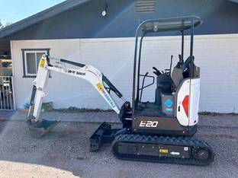
To get Started:
Excavating
If company is going to provide Landscaping and Retaining wall capability, there is a requirement to dig
Light duty Excavator x1: Estimated $19k-$35k
Shipping: Depending on Locations: $1000-$5000
Possibility or Renting until Adjusted Requirements
Photo by Fastline.com
Notes:
To provide landscaping and building services, it is an inevitable a need to dig. An excavator can be an investment, but we have options. There is no need for anything other than a light option. It could otherwise be overkill and a waste of resources to go larger. The estimates are dependent on new and used, as well as the area where the equipment is found. The most cost-efficient course is the way to go. There will be no lack of research for this equipment but not going to be cheap either. The deal needs to meet the needs and will come from Jim Bob’s input as well. There is an option to rent this equipment initially until opportunity presents for purchase.

Slide 8
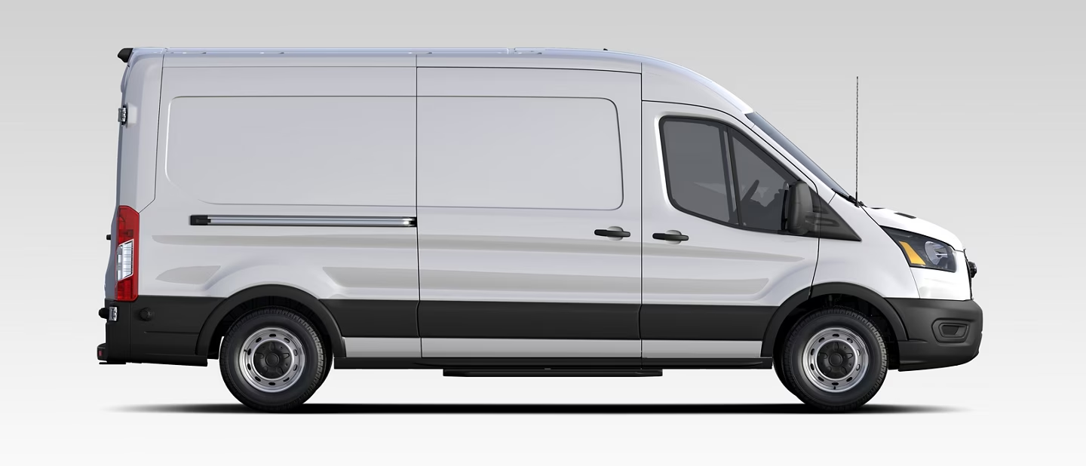
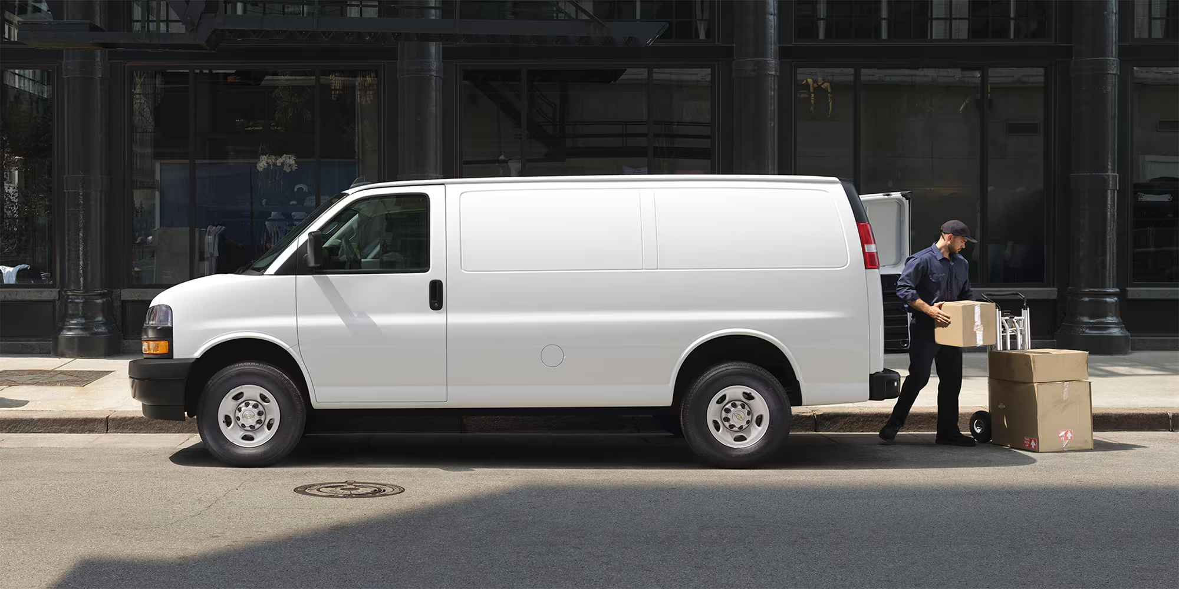
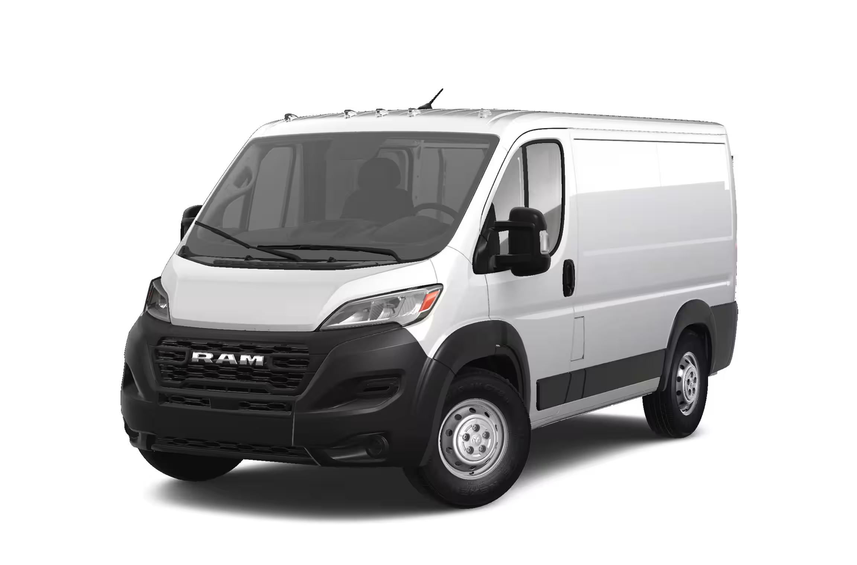
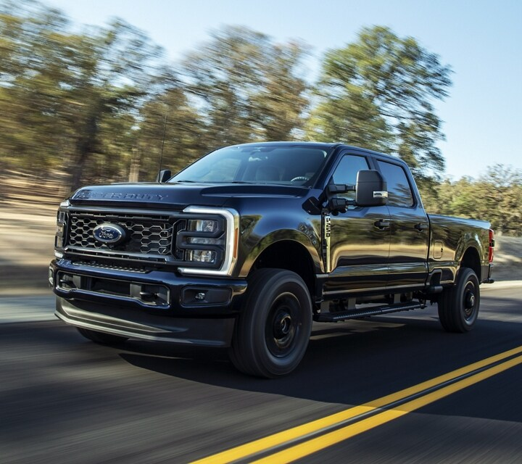
To get Started:
Fleet
Brand options Assessed:
Ford
Chevrolet
RAM
Heavy Duty x1: Estimated $44k-$47k
Transit x3: Estimated $42k-$47k per
Photos from Ford.com, Chevrolet.com, and RAMTrucks.com
Notes:
Our transit vehicles can manage the load for our utility trailers holding the lawn equipment and supplies. The heavy equipment is needed for the excavator, and anything supplies for the job. These are just 3 companies used in comparison. Researching and considering all our options in the market will happen; this is just providing an idea for our start-up. High quality and cost will be considered here. There is no right answer for these options, but there is a wrong one, so ensuring to be vigilant in decisions will keep waste down. The estimates are presented before you.

Slide 9
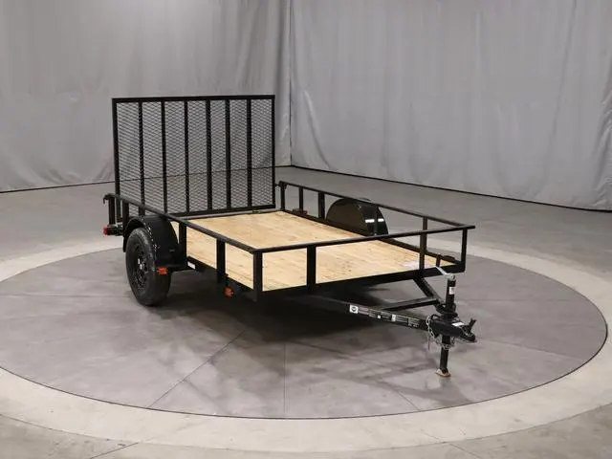
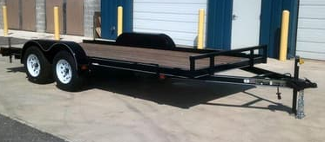
To get Started:
Trailers
Utilitary Trailers x3: Estimate $1300-$3000
Equipment Trailer x1: Estimate $3200-$8000
Photo by TrailersPlus
Notes:
Trailers are not the most expensive part of our needs. The number of trailers can change as we move forward and consider our rental options. Having these available will allow our equipment transport and add value to the company for convenience, if nothing else. The estimated cost here is a decent range of options. Having the equipment on hand will help in the decisions for. The budget can allow for more as needed, depending on which end of the scale the cost falls.

Slide 10
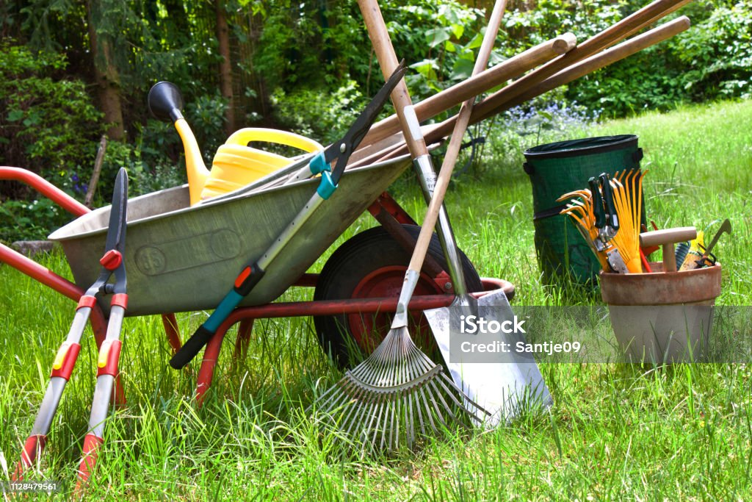
To get Started:
Supplies
Seed
Shovels
Rakes
Bags
PPE
Fuel
Estimate disposables Budget- $2500
Storage Facility $500-$1000 per month
Photo by Santje09
Notes:
Supplies are a necessity for any business. Let’s refer to these as disposable items. These are items that don’t always make it back from the job site every time. Allowing a budget for these to start as opposed to a by-item breakdown will be beneficial to keep waste down, as well as avoid coming up short in the end. The end item on this list is required storage. While we won’t have a physical location for customer walk-ins, we will for our equipment. This makes the business for actionable and less prone to delays in customer requests. There isn’t a need to go shopping as the “disposable” items are available at the drop of a hat. Jim Bob will oversee these things as well and address the proper channels to ensure inventory remains relevant.

Slide 11
Why choose premier
All in One Stop for all Outdoor Needs
Professional and Courteous Staff at all times
Membership Programs
Warranty
Notes:
This is why we’re here. What makes the customer choose Premier over anyone else? As mentioned before, the amount that Premier offers as a service will be unmatched. If other companies are trying to do the same thing, our members make the difference. Experience and know-how set it apart. Professional and courteous experiences are a priority, not a choice. The business also has programs to ensure the quality and extended life of the services and products provided. The work will be covered for a duration of time as well to give the customer confidence that their money is worth while.

Slide 12
Things to consider
Workforce Compiled
Start-up Cost
Website
Equipment
Marketing
Seasonal Changes
Notes:
What will delay the start is down to a couple of things. The workforce will be considered and trained. Hopefully, there can be a good amount of experience on the teams and cut costs with inexperienced apprentices as well. Still, the challenge to conduct efficient background checks and build a worthy staff will take time. The costs can be scary, so ensuring the resources are maximized to get off the ground is essential. Marketing needs to get out to the customer. We have ideas, but getting started can be hit or miss. Lastly, we need to keep an eye on seasonal factors. Florida provides a climate that allows for year-round service. Summer heat waves can prove to provide challenges for our product and employees.

Slide 13
What’s to Gain?
Providing commercial services for businesses- Contracts and Constant Work
Residential Customers, quick and easy Projects
Growth and Expansion
Photo by Thirdman
Notes:
This is profitable. Everyone requires their grass to be cut. Everyone wants to make their house appealing to the eye. Some want the convenience of not needing to water plants and their grass. Others want the Oasis. Premier provides it all and does it well. Businesses do not hire employees to mow grass; they look for a third party. Again, the opportunity for contracts ensures work for our teams. Once established, we can expand and prosper.

Slide 14
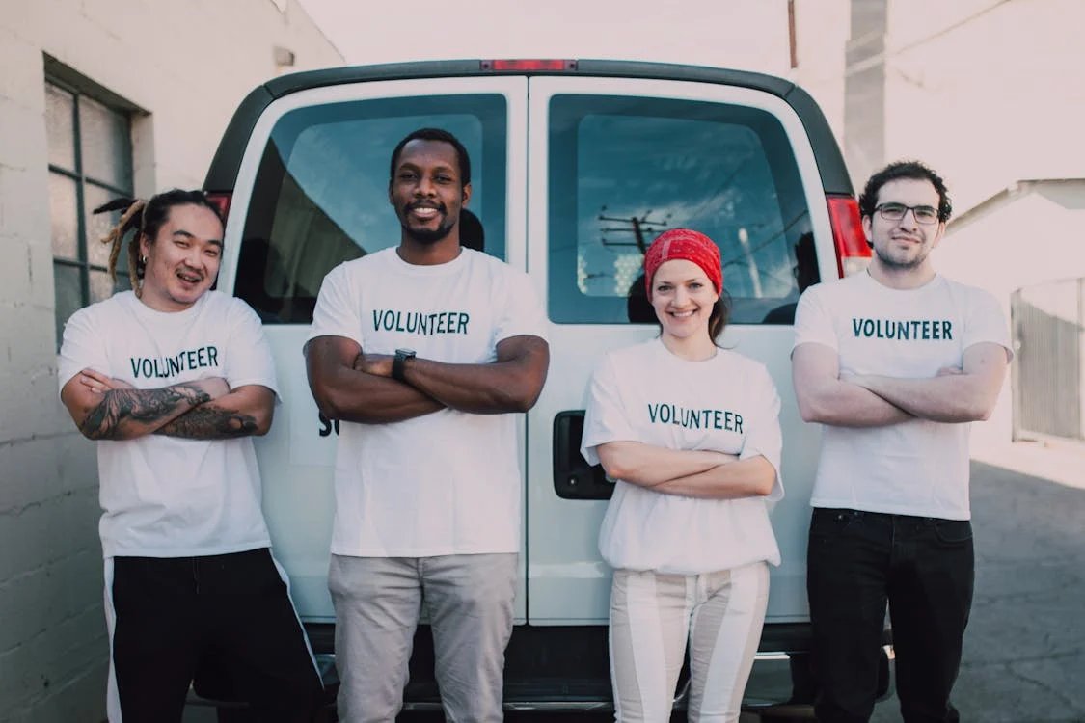
Philanthropy
Providing services to Schools, churches, etc. on agreement basis
Allowing for Word of Mouth Advertising
Respectable and Thankful Customers
Build a Positive Image of Premier
Photo by RDNE Stock Project
Notes:
There is also a philanthropy opportunity here. We think of starting with schools and churches. These are high-traffic areas that people see and think that the company could work for them. Providing an initial free service and paid follow-up for cutting services, and building services under discounts and agreements, brings a huge word-of-mouth marketing to those who attend those establishments. This can be profitable from built contracts as well. It also builds a positive reputation within the community.

Slide 15
What Stands
in the way
Plethora of Competition
Gaining Clients
Photo by Pixabay
Notes:
Other companies out there provide portions of each service provided by Premier. They can offer lower prices and undercut our business. There is always a chance for lawsuits depending on the circumstances from these individuals or businesses. This is a way of the world that can’t be avoided. Risk management shows that this will happen eventually. Our last threat is building a viable client list and portfolio. Slow running to start could be the truth. Believing that our marketing plan and our philanthropy effort will work is a chance as well. The challenge is still there to gain confidence in our abilities to execute

Slide 16
Noone does better than premier
Shane Keilholtz

Slide 17
References
2024 Ford super duty® commercial truck: Pricing, photos, Specs & More. Ford Motor Company. (n.d.-a). https://www.ford.com/commercial-trucks/super-duty/2024/?gnav=header-commercial-vhp
2024 Ford Transit® full-size cargo van: Pricing, photos, Specs & More. Ford Motor Company. (n.d.-b). https://www.ford.com/commercial-trucks/transit-cargo-van/2024/?gnav=header-commercial-vhp
2025 RAM heavy duty professional trucks: 2500 & 3500. RAMTrucks. (n.d.-a). https://www.ramtrucks.com/ram-heavy-duty/professional.html
2025 Ram ProMaster® Cargo van: Ram Van. RAMTrucks. (n.d.-b). https://www.ramtrucks.com/ram-promaster.html
Bobcat E20 excavators for sale new & used | Fastline. (n.d.-a). https://www.fastline.com/construction-equipment-for-sale/listings/bobcat-e20-excavators/results?category=Excavators&manufacturer=Bobcat&model=E20
Barry Witcher. (2020). Absolute Essentials of Strategic Management. Routledge
Business storage: Houston, TX: Myplace self-storage. My Place Self Storage. (2025, April 21). https://myplaceselfstorage.com/storage-locations/tx/houston/12555-northborough-dr/houston-business-storage/
CANVA: Visual suite for everyone. SWOT Template. (n.d.). https://www.canva.com/
Equipment Trailers for Sale Orlando, Florida. TrailersPlus. (n.d.-a). https://www.trailersplus.com/Florida/Orlando/inventory/Equipment/

Slide 18
References Continued…
Excavator training (online course): Certification & License. Hard Hat Training. (2025, March 5). https://www.hardhattraining.com/safety-training/360-excavator-online-training/?srsltid=AfmBOoqsjtLhEncQufE3TG0p-VVJsD59UETJdm6AHZJIMx1IUJ3uodyC
Express vans. Chevrolet. (n.d.-a). https://www.chevrolet.com/commercial/express
Free stock photos, royalty free stock images & Copyright Free Pictures · Pexels. (n.d.-b). https://www.pexels.com/
Irrigation technician salary in Florida: Hourly rate (2025). (n.d.-c). https://www.ziprecruiter.com/Salaries/Irrigation-Technician-Salary--in-Florida
Lawn Care Worker salary in Florida: Hourly rate (jan, 2025). (n.d.-e). https://www.ziprecruiter.com/Salaries/Lawn-Care-Worker-Salary--in-Florida
Lawn Care Worker salary: Hourly Rate May 2025 USA. (n.d.-d). https://www.ziprecruiter.com/Salaries/Lawn-Care-Worker-Salary
Lowe’s Store locator. (n.d.-f). https://www.lowes.com
Salary: Construction builder in Florida (December, 2024). (n.d.-g). https://www.ziprecruiter.com/Salaries/Construction-Builder-Salary--in-Florida
Salary: HR manager in Florida (April, 2025). (n.d.-h). https://www.ziprecruiter.com/Salaries/Hr-Manager-Salary--in-Florida
Search. Toro. (n.d.-a). https://www.toro.com/en/search?q=edger&page=1&tabpage=1&activetab=1

Slide 19
References Continued…
Search. Toro. (n.d.-b). https://www.toro.com/en/search?q=trimmers&page=1&tabpage=1&activetab=1
Section 14. SWOT analysis: Strengths, weaknesses, opportunities, and threats. Chapter 3., Section 14. SWOT Analysis: Strengths, Weaknesses, Opportunities, and Threats - Main Section | Community Tool Box. (n.d.). https://ctb.ku.edu/en/table-of-contents/assessment/assessing-community-needs-and-resources/swot-analysis/main#:~:text=What%20are%20the%20elements%20of,be%20recognized%20and%20possibly%20addressed
Silverado HD. Chevrolet. (n.d.-b). https://www.chevrolet.com/commercial/previous-year/silverado/2500hd-3500hd
Trailers for sale in Florida. TrailersPlus. (n.d.-b). https://www.trailersplus.com/Florida/?srsltid=AfmBOoqH0-5fl9nVm7isUpD2Jn-bDs3x29RpS276BQmbNuOrsxmfEBiU
Web project manager annual salary in Orlando, FL ($64,810 avg | Mar 2020) - ziprecruiter. (n.d.-i). https://www.ziprecruiter.com/Salaries/How-Much-Does-a-Web-Project-Manager-Make-a-Year-in-Orlando,FL
Z master® gas 2000 series. Toro. (n.d.-c). https://www.toro.com/en/product/Z-Master-2000-Gas-Zero-Turn-Riding-Lawn-Mower

