Slide 1
Inventions Throughout history
By: Shane Keilholtz

Slide 2
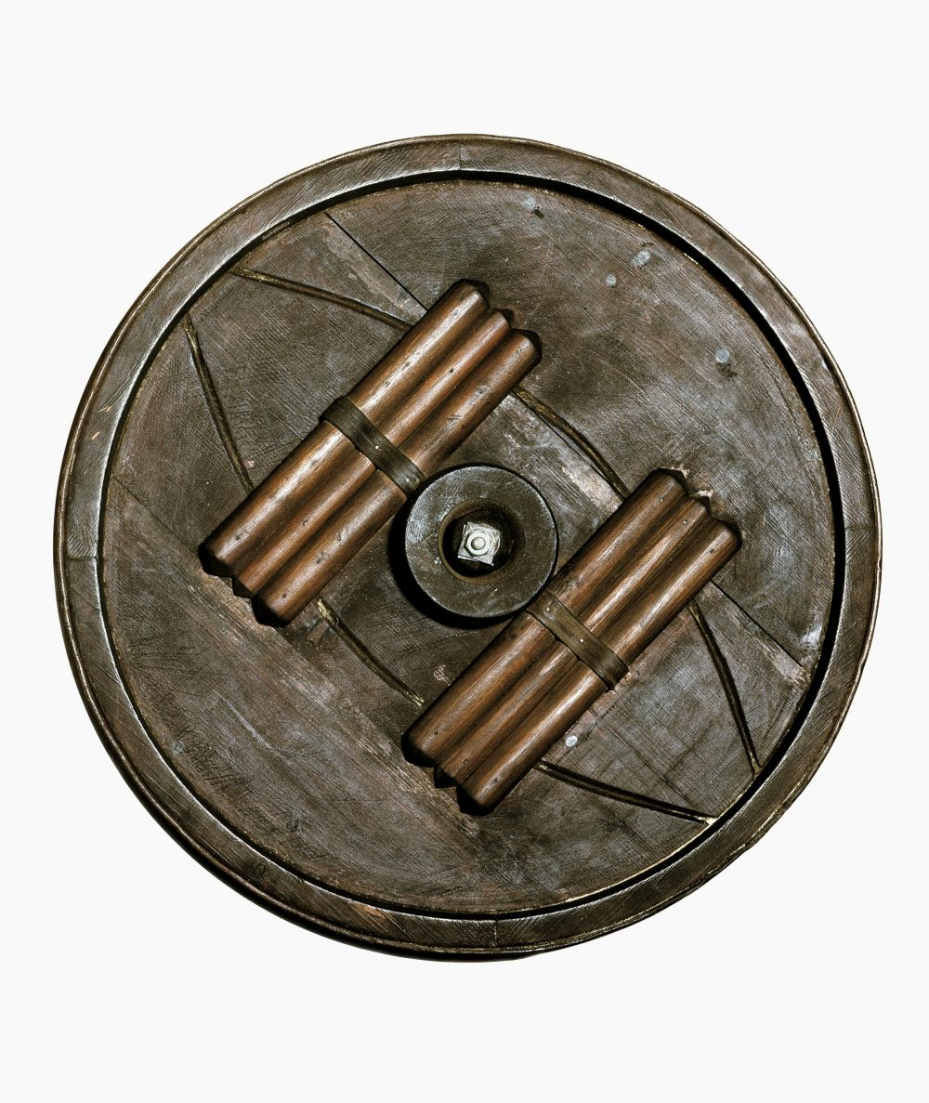
The wheel

Slide 3
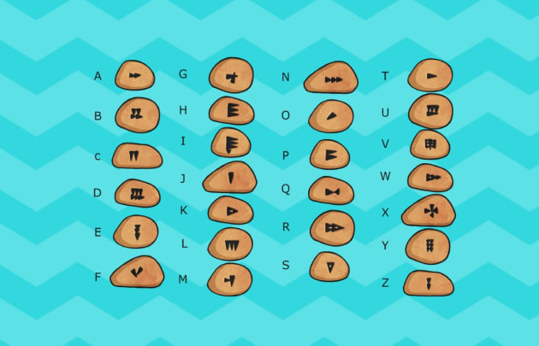
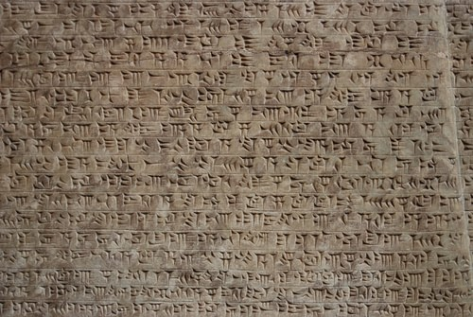
Writing

Slide 4
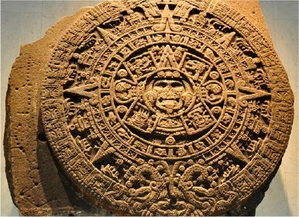
The calendar

Slide 5
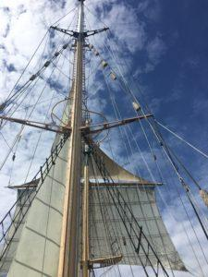
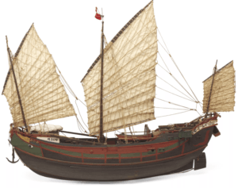
The sail

Slide 6
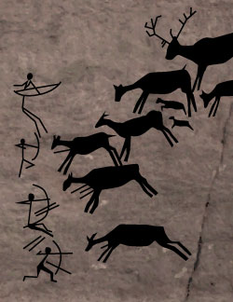
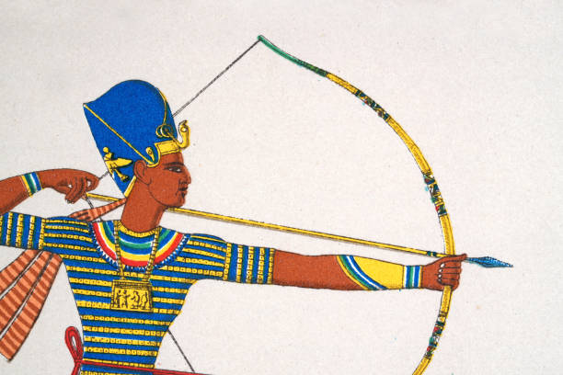
Bow and arrow

Slide 7
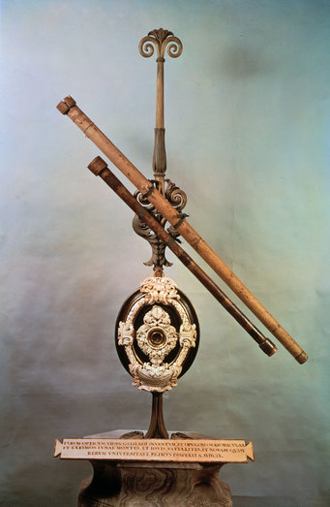
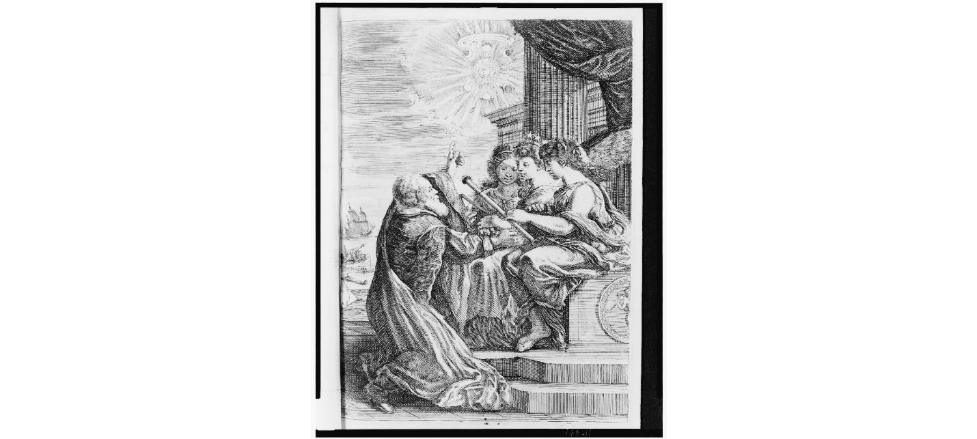
telescope

Slide 8
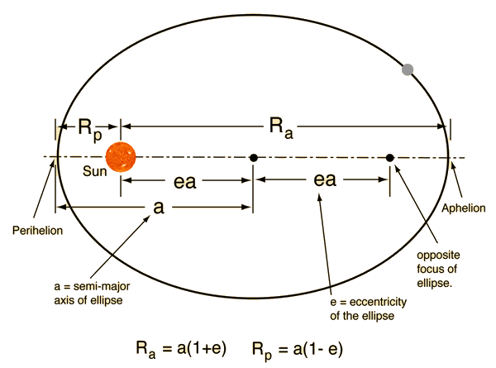
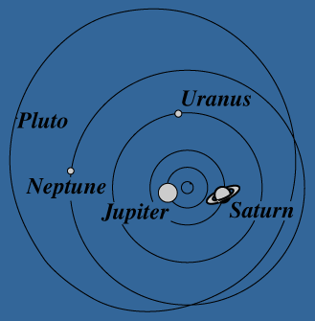
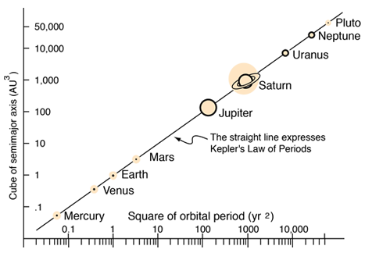
Kepler’s Planetary Laws

Slide 9
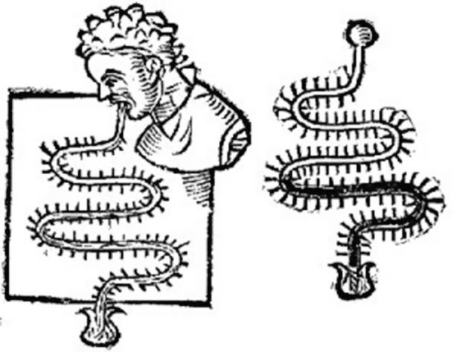
Thermoscope

Slide 10
Newtons laws of Gravity

Slide 11
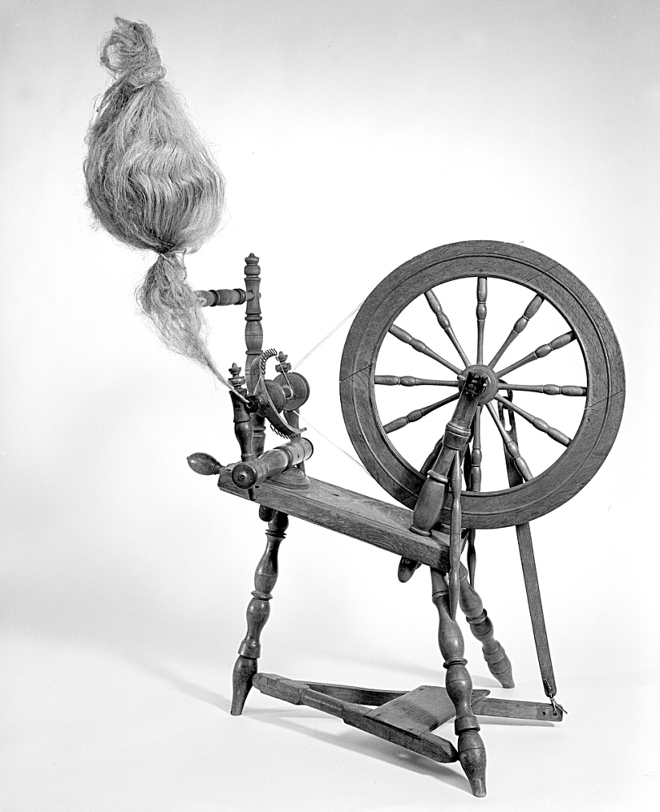
Flax spinning wheel

Slide 12
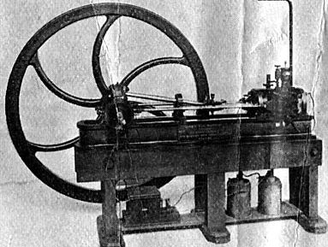
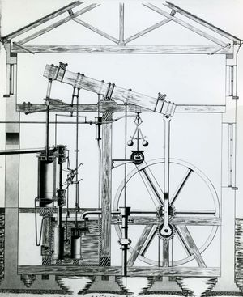
Steam engine

Slide 13
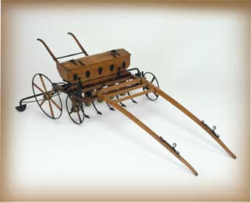
Seed drill

Slide 14
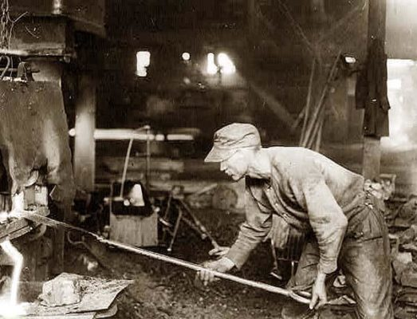
Puddling iron

Slide 15
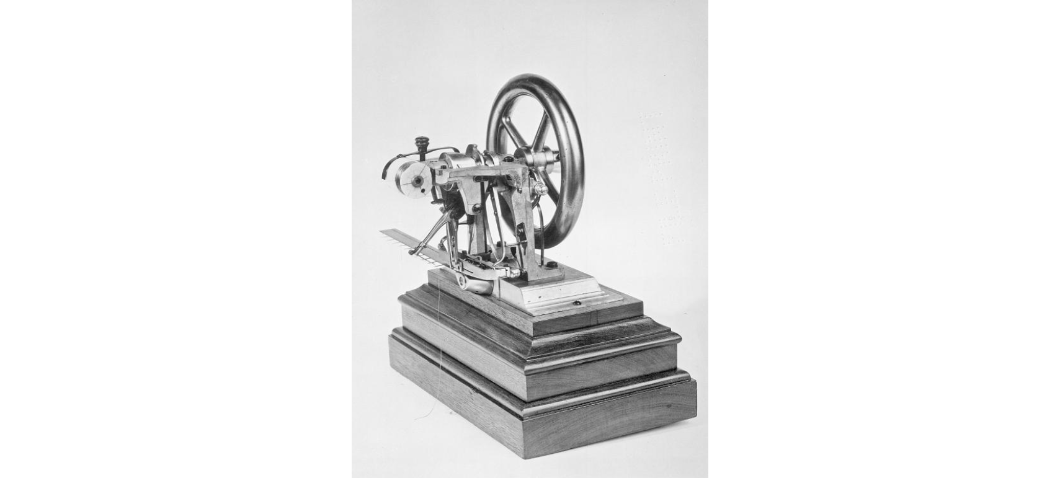
Sewing machine

Slide 16
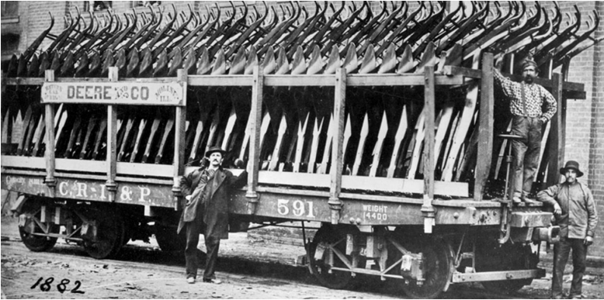
Steel plow

Slide 17
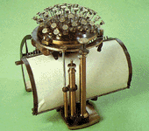
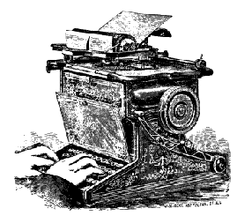
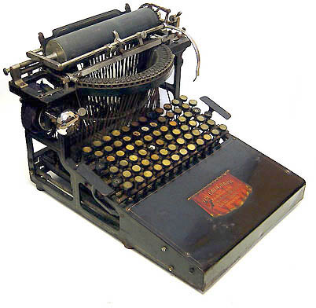
typewriter

Slide 18
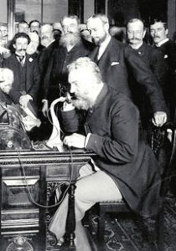
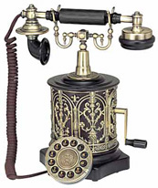
Alexander graham bell’s telephone

Slide 19
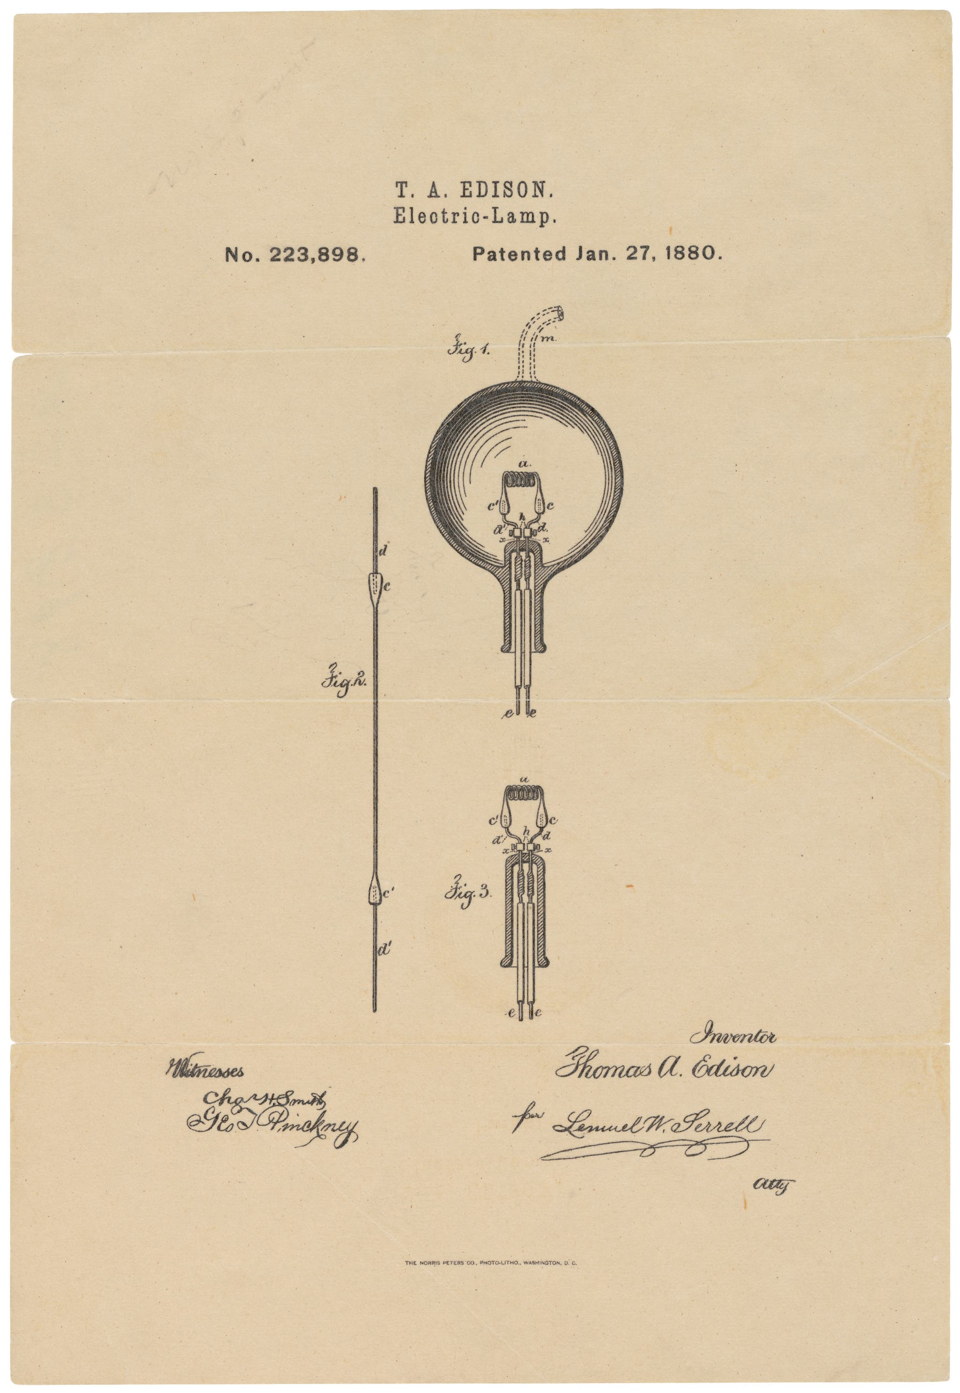
Edison’s carbon filament

Slide 20
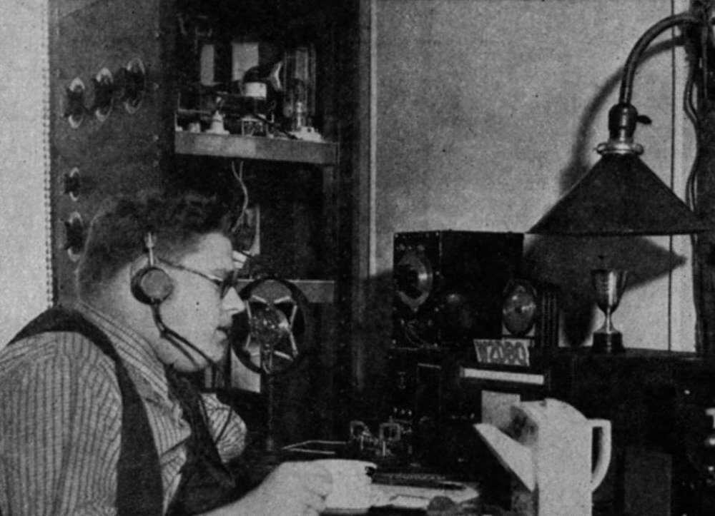
The radio

Slide 21
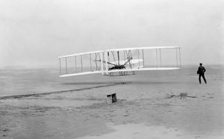
The airplane

Slide 22
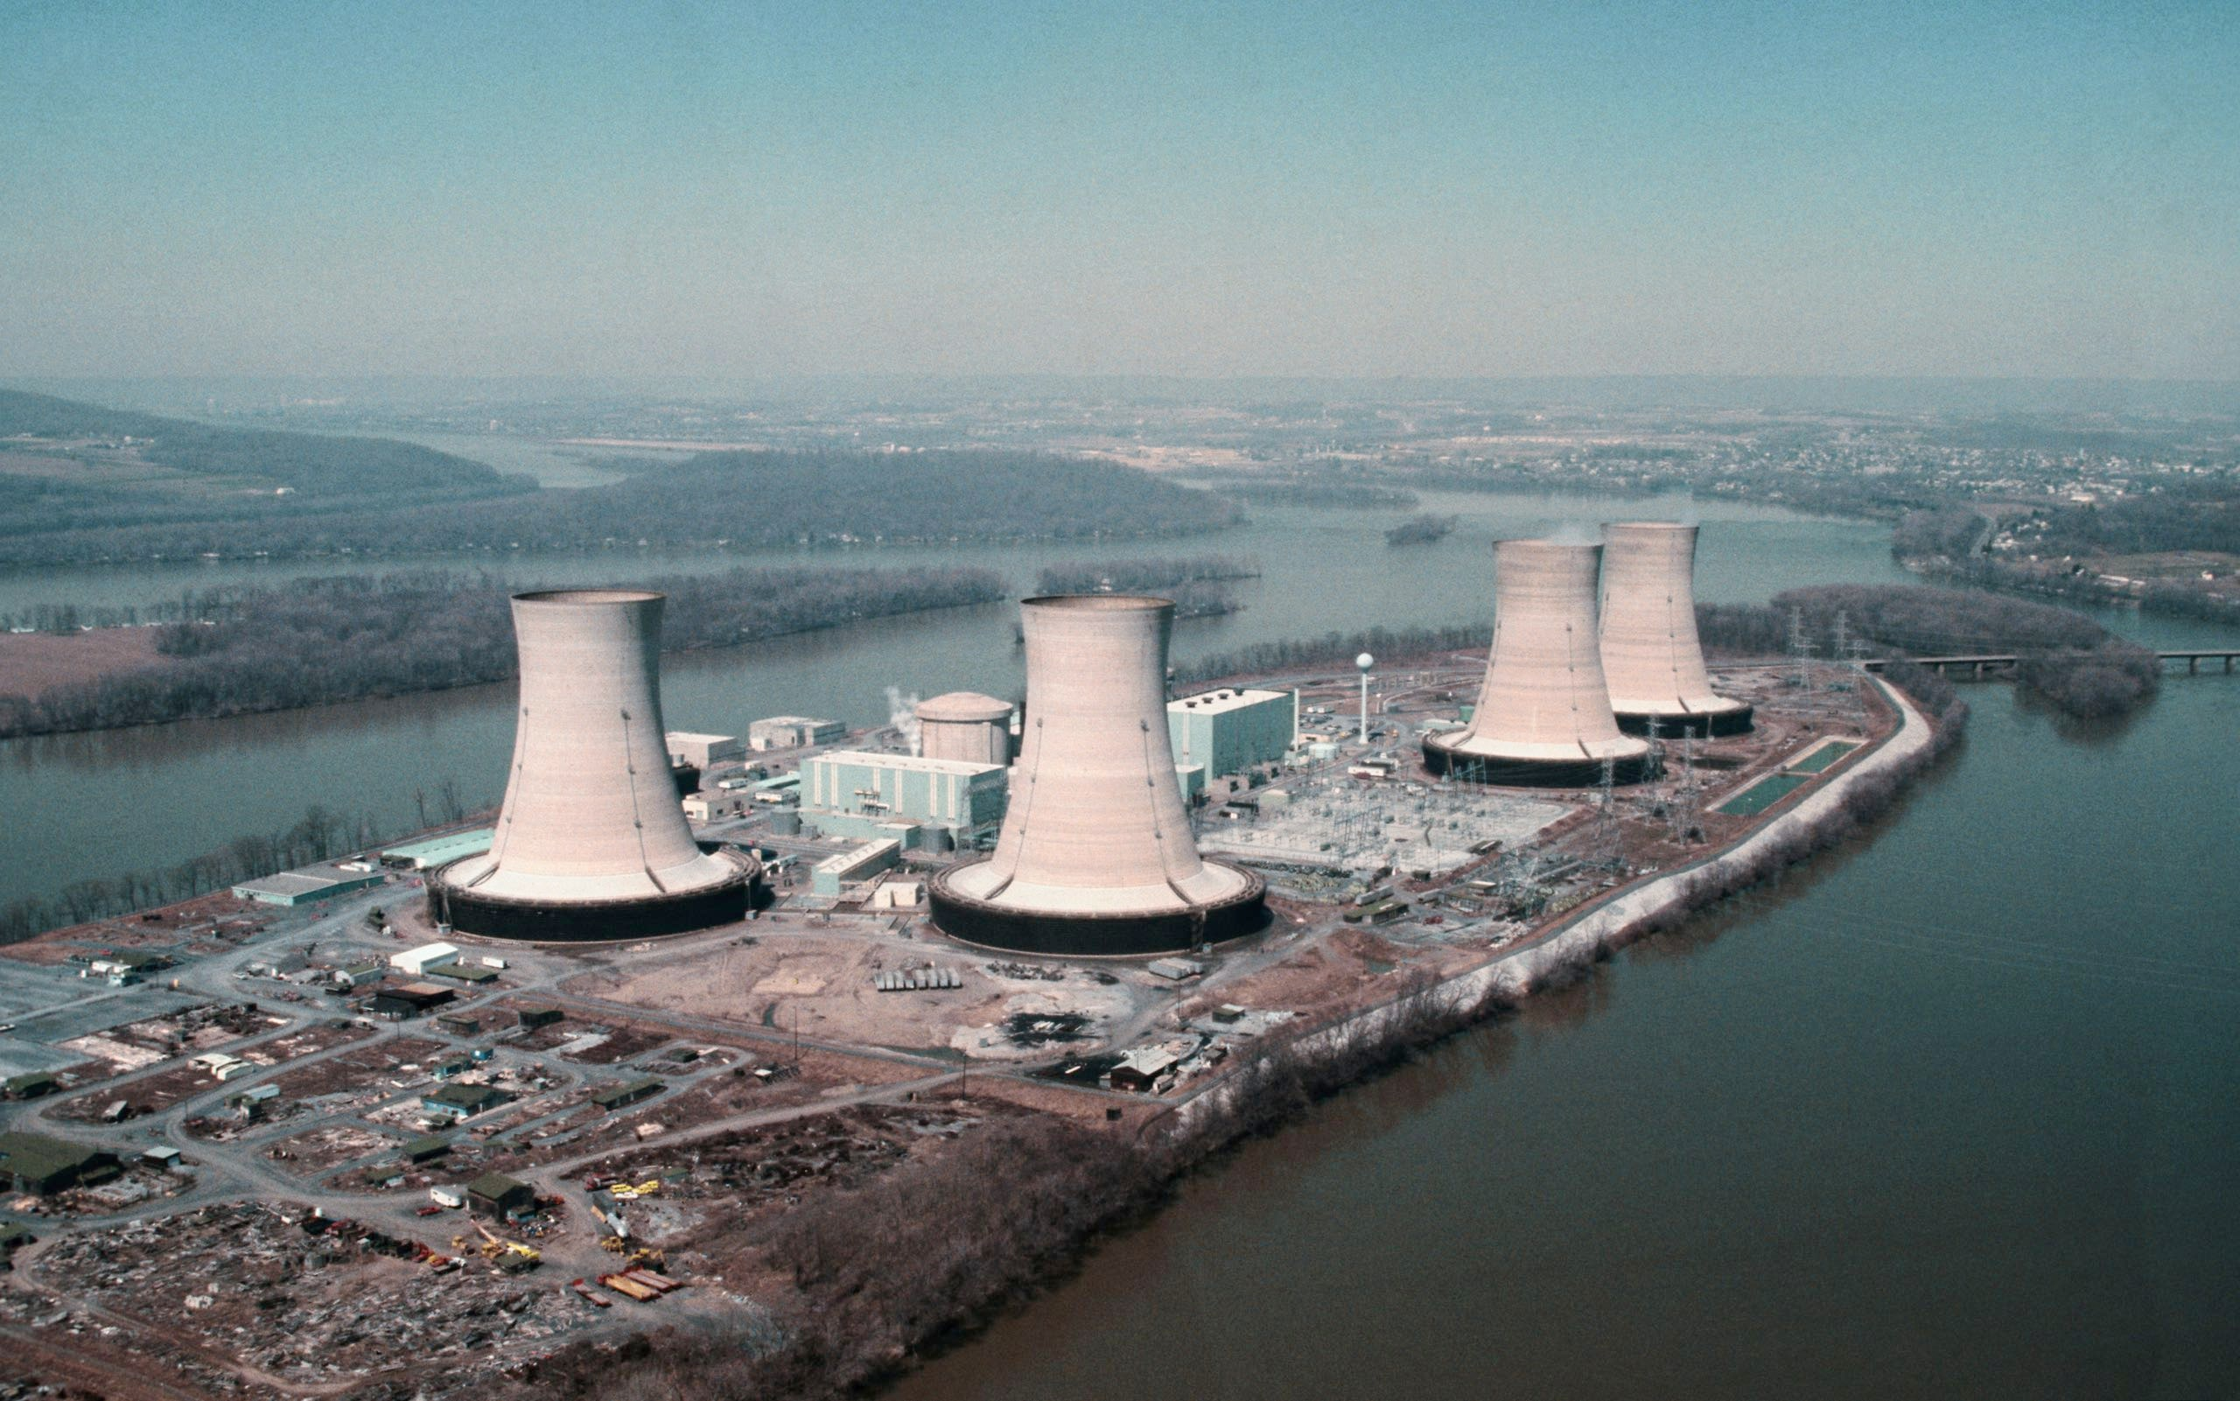
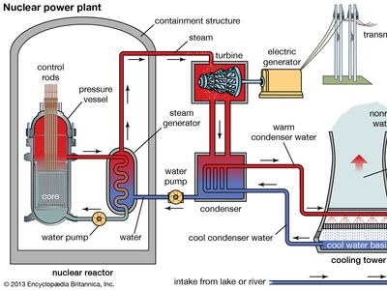
Nuclear power plants

Slide 23
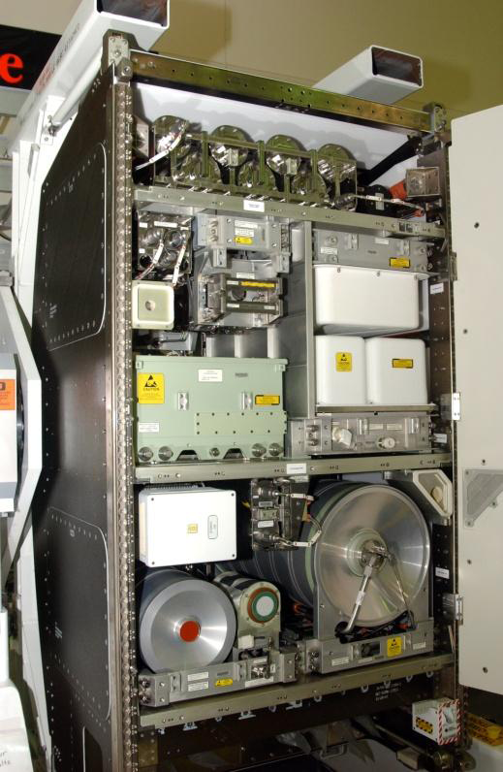
Water filters

Slide 24
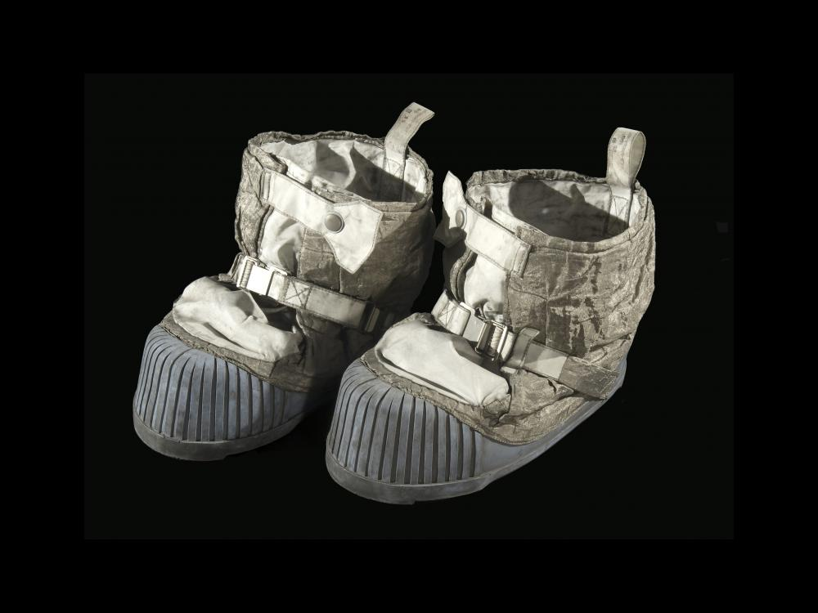
Shoe insoles

Slide 25
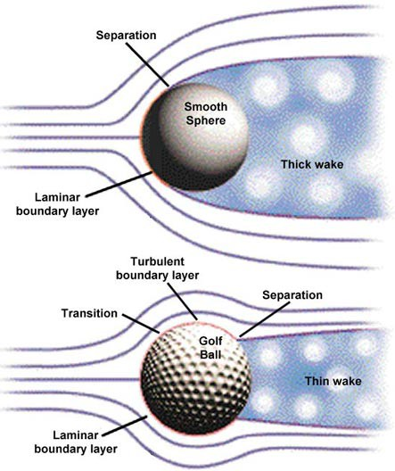
Aerodynamic advancements

Slide 26
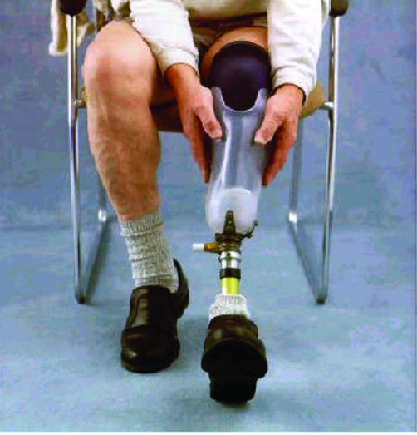
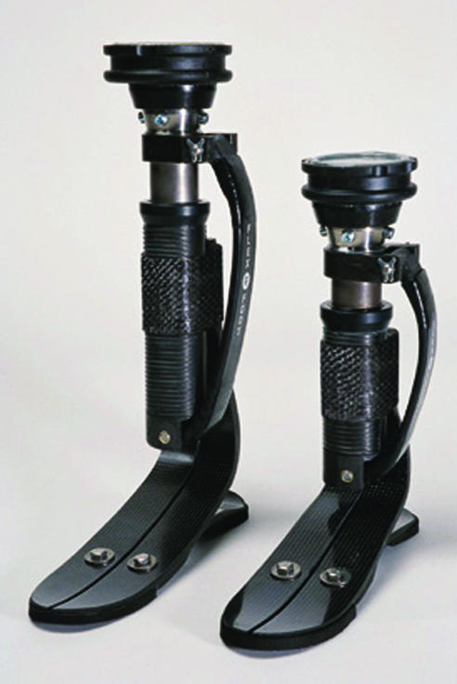
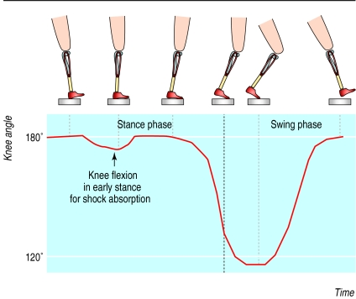
Artificial limbs

Slide 27
I hope you enjoyed!

Slide 28
References
-10000 years of economy. (n.d.). https://www.citeco.fr/10000-years-history-economics/the-origins/invention-of-the-wheel#:~:text=The%20wheel%20was%20invented%20in,advances%20in%20two%20main%20areas.
-1846 - Elias Howe Jr.’s Sewing Machine Patent Model. National Museum of American History. (n.d.-a). https://americanhistory.si.edu/collections/search/object/nmah_630930
-1870s – 1940s: Telephone. Elon University. (n.d.). https://www.elon.edu/u/imagining/time-capsule/150-years/back-1870-1940/#:~:text=The%20Development%20of%20the%20Telephone&text=While%20Italian%20innovator%20Antonio%20Meucci,for%20the%20device%20in%201876.
-A&E Television Networks. (n.d.). When Edison Turned Night Into Day. History.com. https://www.history.com/news/when-edison-turned-night-into-day
-A brief history of typewriters. (n.d.). https://site.xavier.edu/polt/typewriters/tw-history.html
-A cure for hooks and slices? Asymmetric Dimple patterns and Golf Ball Flight: Science Project. Science Buddies. (n.d.). https://www.sciencebuddies.org/science-fair-projects/project-ideas/Sports_p012/sports-science/golf-ball-patterns
-Advanced NASA technology supports water purification efforts worldwide. ESA. (n.d.). https://www.esa.int/Science_Exploration/Human_and_Robotic_Exploration/International_Space_Station_Benefits_for_Humanity/Advanced_NASA_Technology_Supports_Water_Purification_Efforts_Worldwide
-An organ pipe as a telescope. Galileo Galilei telescope | Max-Planck-Gesellschaft. (2014, February 11). https://www.mpg.de/7913340/galileo-galilei-telescope
-Bertoloni, M. D. E. I., Dorn, H., & McClellan, J. E. I. (2006). Science and technology in world history: An introduction. Johns Hopkins University Press.

Slide 29
References Cont.
-Dao, C. (n.d.). Man of science, man of god: Isaac Newton. The Institute for Creation Research. https://www.icr.org/article/newton/
-Encyclopedia.com. (2023, October 24).." Gale encyclopedia of u.s. economic history.. encyclopedia.com. 18 Oct. 2023. Encyclopedia.com. https://www.encyclopedia.com/history/encyclopedias-almanacs-transcripts-and-maps/steel-plow
-Encyclopædia Britannica, inc. (2023, September 28). Steam engine. Encyclopædia Britannica. https://www.britannica.com/technology/steam-engine
-Encyclopædia Britannica, inc. (2023, October 27). Sewing machine. Encyclopædia Britannica. https://www.britannica.com/technology/sewing-machine
-Encyclopædia Britannica, inc. (2023b, November 3). Nuclear power. Encyclopædia Britannica. https://www.britannica.com/technology/nuclear-power
-Encyclopædia Britannica, inc. (n.d.). The generation and application of power: The problem of propulsion. Encyclopædia Britannica. https://www.britannica.com/technology/history-of-flight/The-generation-and-application-of-power-the-problem-of-propulsion
-Flax spinning wheel. National Museum of American History. (n.d.). https://americanhistory.si.edu/collections/search/object/nmah_1200991
-Flax spinning wheel; New York, 18th C. National Museum of American History. (n.d.). https://americanhistory.si.edu/collections/search/object/nmah_640675

Slide 30
References Cont.
-Galileo and the telescope: modeling the cosmos: articles and essays: finding our place in the cosmos: From Galileo to Sagan and beyond: digital collections: library of Congress. The Library of Congress. (n.d.). https://www.loc.gov/collections/finding-our-place-in-the-cosmos-with-carl-sagan/articles-and-essays/modeling-the-cosmos/galileo-and-the-telescope#:~:text=While%20there%20is%20evidence%20that,Jacob%20Metius%20independently%20created%20telescopes.
-Grodzinsky, E., & Sund Levander, M. (2019, August 23). History of the thermometer. Understanding Fever and Body Temperature: A Cross-disciplinary Approach to Clinical Practice. https://www.ncbi.nlm.nih.gov/pmc/articles/PMC7120475/#:~:text=Thermoscopy-,The%20earliest%20thermal%20instruments%20were%20developed%20during%20the%20sixteenth%20and,open%20thermometers%20were%20termed%20thermoscopes.
-History of the bow and Arrow. Hunter. (n.d.). https://www.hunter-ed.com/pennsylvania/studyGuide/History-of-the-Bow-and-Arrow/20103901_88583/
-Hodge, K. (2020, January 17). How sailing happened. Project Archaeology. https://projectarchaeology.org/2020/01/17/how-sailing-happened/
-Jethro Tull. ASME. (n.d.). https://www.asme.org/topics-resources/content/jethro-tull
-Kepler’s laws. (n.d.). http://hyperphysics.phy-astr.gsu.edu/hbase/kepler.html
-Kobus, K. J. (2015). City of steel: How Pittsburgh became the world's steelmaking capital during the carnegie era. Rowman & Littlefield Unlimited Model.

Slide 31
References Cont.
-Magazine, A. A. S. (2023, May 28). 10 everyday NASA inventions and spin-offs you can find in your home. Space.com. https://www.space.com/10-everyday-nasa-inventions-spin-offs-in-you-home
-Mark, J. J. (2019, October 11). Mesopotamian Science and Technology. World History Encyclopedia. https://www.worldhistory.org/Mesopotamian_Science/
-Marks, L. J., & Michael, J. W. (2001, September 29). Science, medicine, and the future: Artificial limbs. BMJ (Clinical research ed.). https://www.ncbi.nlm.nih.gov/pmc/articles/PMC1121287/
-Mertes, A. (2023, September 27). Who invented the calendar? A history of days, months, & years. Promotional Products Blog. https://www.qualitylogoproducts.com/blog/history-of-calendars/#:~:text=The%20Sumerians%20in%20Mesopotamia%20made,the%20one%20we%20use%20today.
-Nick. (2022, August 31). Wrought iron. The Small Workshop. https://smallworkshop.co.uk/2017/10/29/wrought-iron/
-Overshoes from the last man on the Moon. Homepage. (n.d.). https://airandspace.si.edu/stories/editorial/overshoes-last-man-moon
-Planetary and satellite motion. Law of Gravity. (n.d.). https://physics.weber.edu/amiri/physics1010online/WSUonline12w/OnLineCourseMovies/CircularMotion&Gravity/reviewofgravity/ReviewofGravity.html
-Public Broadcasting Service. (n.d.). The development of Radio. PBS. https://www.pbs.org/wgbh/americanexperience/features/rescue-development-radio/

Slide 32
References Cont.
-Schell, J. (1979, June 18). The implications of the accident at Three Mile Island. The New Yorker. https://www.newyorker.com/magazine/1979/06/25/comment-three-mile-island
-The history of the light bulb. Energy.gov. (n.d.). https://www.energy.gov/articles/history-light-bulb
-“The original steel plow” and John Deere, 1882. “The Original Steel Plow” and John Deere, 1882 | State Historical Society of Iowa. (n.d.). https://history.iowa.gov/history/education/educator-resources/primary-source-sets/iowas-corn-and-agriculture-industry/original-steel
-Twinkl.com. (n.d.). https://www.twinkl.com/teaching-wiki/ancient-mesopotamian-writing

